Slide 1
ESYNC Overview
Jason Strom
28 January - 1 February 2019
NIPWG 6 - Rostock, Germany

Slide 2
Current Process for Updating Products
Most update solutions today rely on building custom patches and levying apply processing on the end user
Results in labor-intensive effort by the data provider to produce, quality check, and distribute patch products
Results in labor-intensive effort by an end user to retrieve and apply patch products
Most update solutions today rely on a baseline where unique patches are only applied to a specific baseline
Digital Nautical Charts (DNC) use cumulative Vector Database Updates (VDU) that can only be applied to specific DNC Editions
Electronic Navigational Charts (ENC) use sequential patch updates that can only be applied to a Base ENC Cell

Slide 3
NGA DNC Updating Today
DNC
E
D
I
T
I
ON
X
DNC
E
D
I
T
I
ON
Y
Requires NGA production of cumulative VDU
VDU can only be applied to specific DNC Edition
VDU can only be applied to specific DNC Edition
Requires applying VDU to specific DNC Edition
Large file size limits download
in low bandwidth
Limits updating until new DNC Edition download
Labor-intensive production of unique patches
VDU
VDU
Labor-intensive apply processing by end user
VDU
VDU
VDU
VDU
VDU
...
VDU
...
T₀
T₁
T₂
T₃
T₁₁
T₀
T₁
T₂
T₃
T₁₁

Slide 4
Updating with ESYNC
ESYNC incorporates differencing in the infrastructure
Eliminates source production of unique patches
Eliminates end user need to apply unique patches
ESYNC server and client manages patch/apply process
Server creates and caches frequently used patches
Server dynamically creates any required patch
Client manages obfuscated requests for patches
Client automatically applies patches for end user
ESYNC addresses bandwidth and mission concerns
Reduces bandwidth requirement to maintain charts
Eliminates limitation of traversing boundaries (i.e. release of new DNC Edition or new Base ENC Cell)

Slide 5
NGA DNC Updating with ESYNC
Eliminates NGA production of cumulative VDU
Limits updating until new DNC Edition download
ESYNC patch can be applied to any DNC Edition
ESYNC patch can be applied to any DNC Edition
Smaller file size (zipped files) for download
in low bandwidth
DNC
E
D
I
T
I
ON
X
DNC
E
D
I
T
I
ON
Y
About 10x faster applying process by end user
VDU
VDU
VDU
...
VDU
...
V
D
U
V
D
U
V
D
U
V
D
U
T₀
T₁
T₂
T₃
T₁₁
T₀
T₁
T₂
T₃
T₁₁

Slide 6
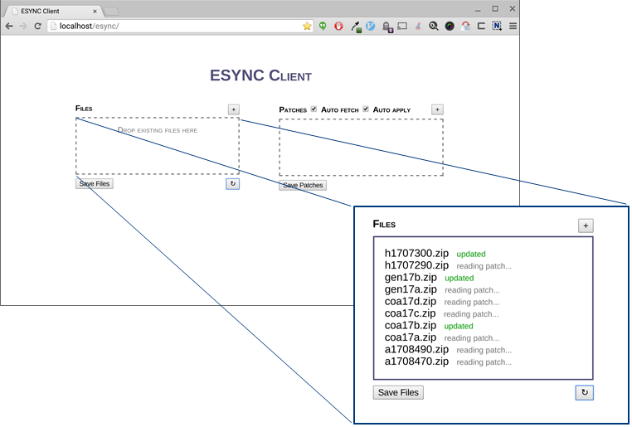
ESYNC Client

Slide 7
Benefits of ESYNC
ESYNC is product agnostic
Works with any file type
Works with compressed or uncompressed files
ESYNC Client requires no software installation
Executes on secure browser (IE, Edge, Chrome, Firefox)
Works on desktop computers and mobile devices
ESYNC improves product security
Obfuscates update requests to protect user intent
Ensures integrity of data throughout update process

Slide 8
Future Work with ESYNC
Continue development of the service and offer more pilots and use case scenarios
Fully implement with customer, it would eliminate the cost and logistics associated with sending out physical disks

Slide 9
Summary
ESYNC offers a dramatic shift in production and distribution of NGA product updates
ESYNC offers a dramatic reduction in labor-intensive chart maintenance by navigation teams
Potential to synchronize any data that is periodically updated and distributed to one or more end users
ESYNC fulfills a vital need today for intelligent and secure synchronization of information

